Slide 1
Discussion board Notification Tool Tutorial
Developed by
Nopphon Keerativoranan
Teaching Assistant in OEDO
Last modified 14 October 2019

Slide 2
Objective
To notify course staff and lecturers on the new activities in the MOOCs Tokyo Tech course via email address
To store the discussion board textual data for further analysis

Slide 3















Overview
Scanning new activities
Updating database
DB crawling
[ Initialization ]
Making a report on new DB activities
Scraping new DB activities
Scraping new DB activities
Scraping all DB activities
Reporting to STAFF
Waiting for a certain period (e.g. weekly)
Storing activities into database
Sending the report to staff
Reading staff email from a listing file

Slide 4
Prerequisite items
Dedicated edX account for the detection the new activities in discussion board
Dedicated email address as sender to send the report to desired recipients (Course staff, lecturer)
Dedicated Local machine with Ubuntu OS to execute the program
‘new activities’ is defined as the posts, responses, or comments that the dedicated account has not been checked since the last scanning.

Slide 5
Flowchart
Examine program and files in workspace folder
Filling course url in course table.xlsx
Modified the scheduling information in .sh file
Setup scheduling in the local machine
Execute the update_DB_crawler.py
Filing edX and host email information in accout_info.json
execute the edx_DBcrawler3.py
Modified the email body template (optional)
setting up
Initialization
Scanning new activities
Reporting to staffs

Slide 6







Workspace folder
Contains edX account and host email address
all_dis.json
Contains course URLs and recipients email address
WebDriver for Chrome
https://sites.google.com/a/chromium.org/chromedriver/
Course table.xlsx
chromedriver
Contains crawled data and a new activity report
Bash script for task scheduling in Ubuntu
HTMLs folder
Execute.sh
Python script to crawl NEW DB activity and send email
Python script to crawl all DB content
update_DB_crawler.py
edx_DBcrawler3.py

Slide 7





Additional information of Web Driver
edX discussion board uses a dynamic web element
So, it needs a web browser to handle the dynamic Javascript
Python-Selenium tool
Provides Webdriver APIs of various browsers
Can perform crawling at edX discussion board
(https://www.seleniumhq.org/)
Notes:
Selenium automates browsers. Primarily, it is for automating web applications for testing purposes, but is certainly not limited to just that.

Slide 8
Initialization

Slide 9


execute the edx_DBcrawler3.py
1) Execute the script with the following command
Browser will be opened and goes to edX dashboard of the account indicated in account_info.json
2) The crawler will ask which courses do you want to initially scrape the DB data
Type your choice and the crawler will start scraping all DB data

Slide 10
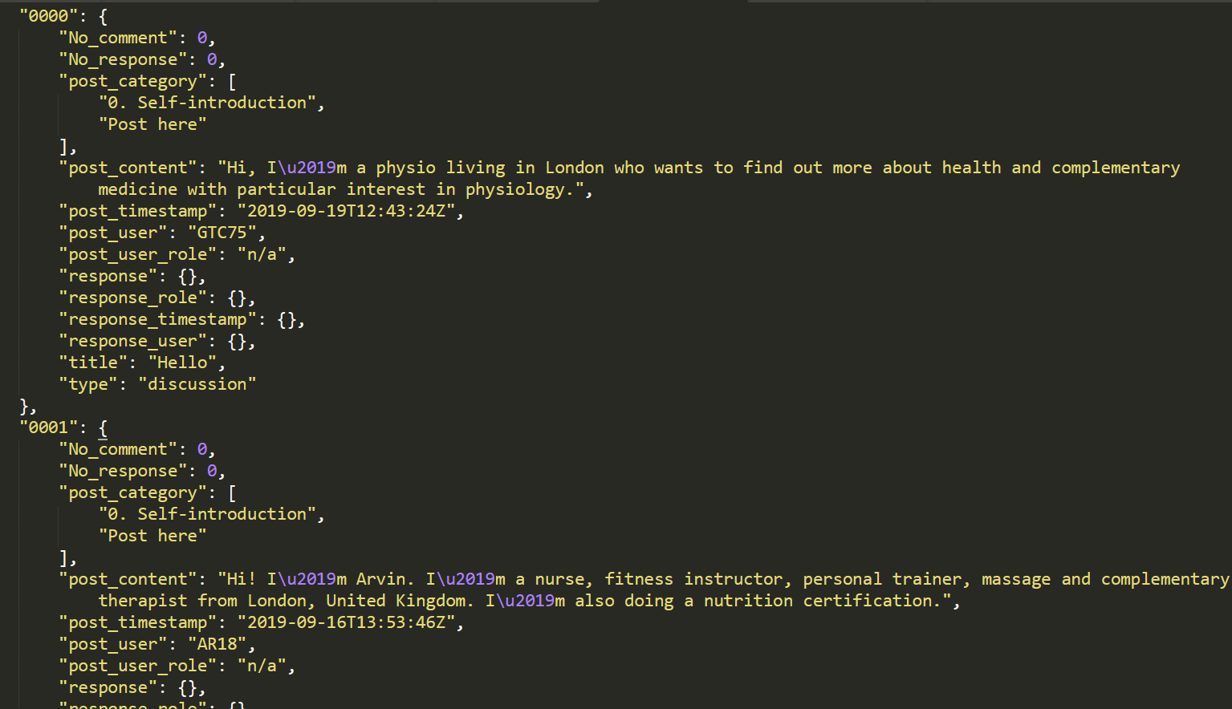
Result
all_dis.json
DB textual data is stored in json-based database
workspace
HTMLs folder
Course 1
Course 2
all_dis.json

Slide 11
Setting up

Slide 12
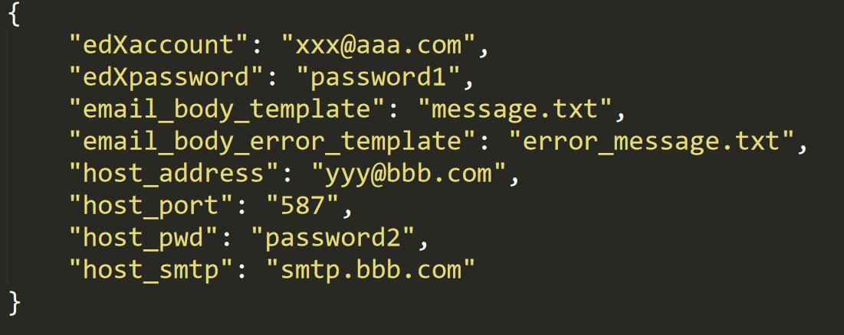
Account Information setup
Dedicated edX account and password for the query of new activities in discussion board
account_info.json
Body template files of email to be sent in case of tool running normally and abnormally
Information of the email sender
Email account
Password
Email protocol (usually smtp)
Email port (usually 587)

Slide 13
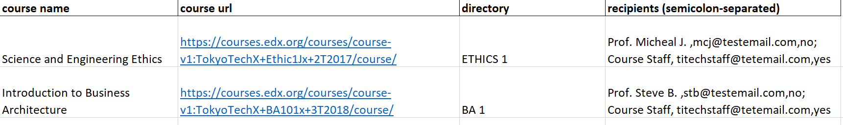
Adding course URL in the excel file
Course URL given from the edX dashboard
course table.xlsx
Make sure the url is correctly added

Slide 14
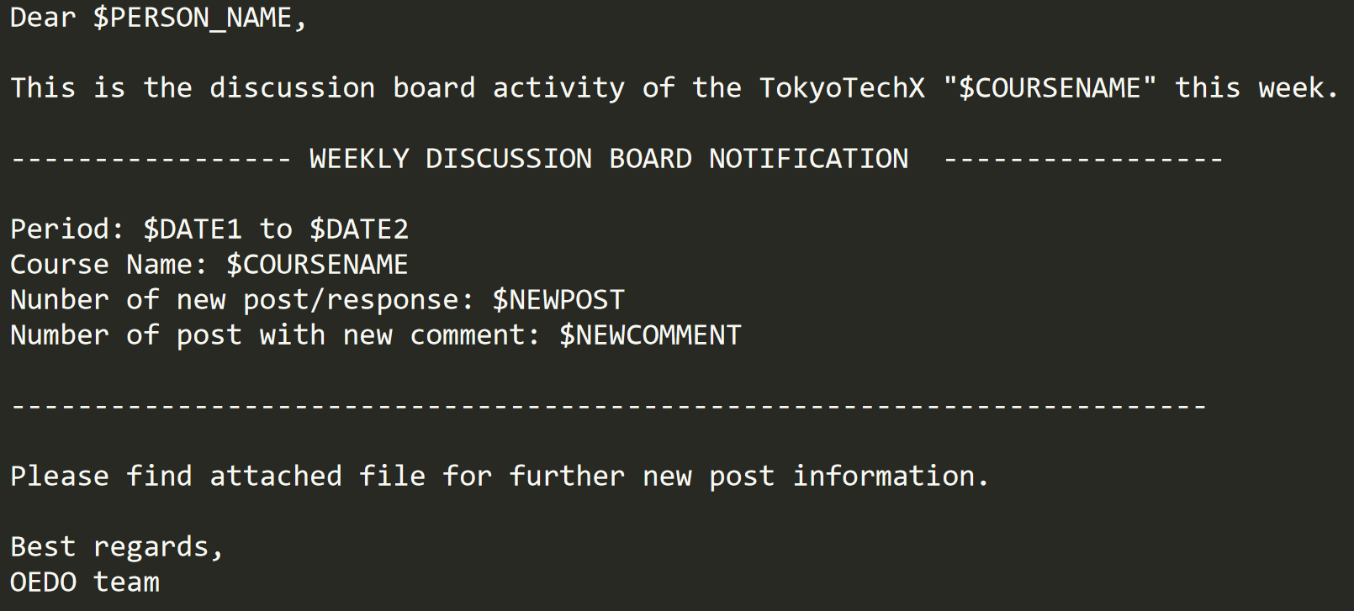
Refer to the course names and recipients listed on course table.xlsx
Email body template [normal case]
Number of new activities found
$DATE2 is the date of crawling
$DATE1 is the date of previous crawling
(7 days ago by default. To change the period, please modify the date inupdate_DB_crawler.py)

Slide 15
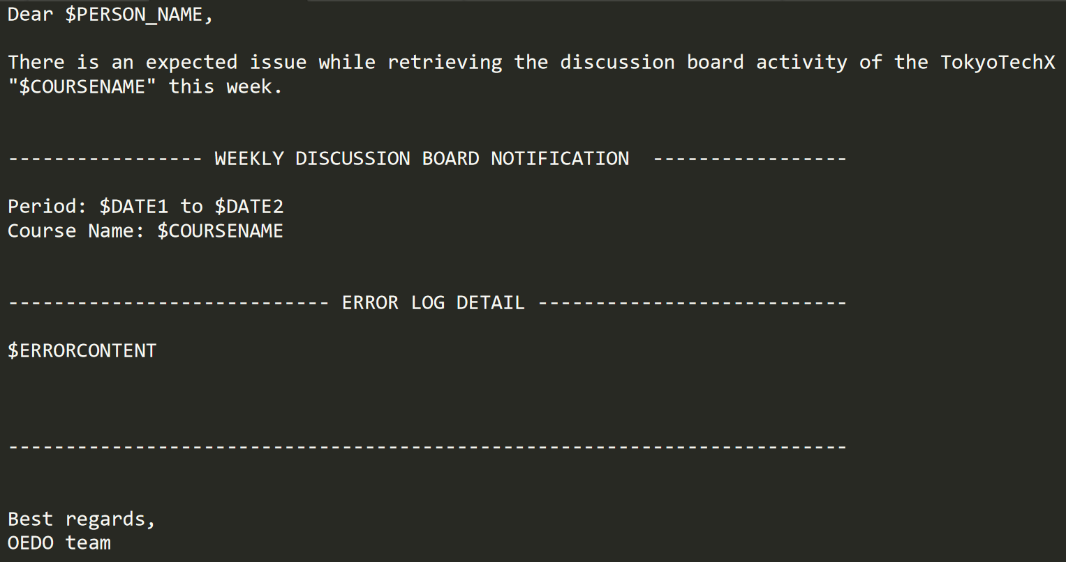
Email body template [error case]
Refer to the course names and recipients listed on course table.xlsx
Number of new activities found
$DATE2 is the date of crawling
$DATE1 is the date of previous crawling
(7 days ago by default. To change the period, please modify the date inupdate_DB_crawler.py)
Error Log reported by the tool

Slide 16
Scanning new activities
&
reporting to staff

Slide 17
Adding directory and recipients information
Subdirectory name inside ‘HTMLs’ folder
course table.xlsx
List of email recipients in the following format
[NAME_1], [EMAIL_1], [FLAG_1] ;
[NAME_2], [EMAIL_2], [FLAG_2] ;
*FLAG → if yes, send email when there are new activities
→ if no, send email even without new activity
You can freely change the directory name but make sure that it is matched with the name in this column

Slide 18
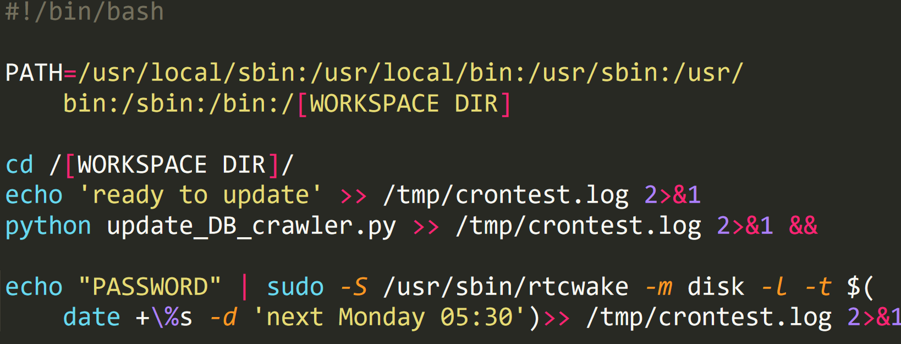
Scheduling setup
Crontab based scheduling in Ubuntu OS
crontab -e
The program will do 3 steps periodically regarding the right panel setup
Wake-up at [TIME_1]
[TIME 2]
Scanning new DB activity
Sending email
Go to sleep mode until [TIME_1]
This line of code asks the OS to execute the execute.sh every [TIME_2] = Monday 6 AM
Your user’s pwd
Replace with your workspace directory.
Ex. [WORKSPACE] → home/auto-db/
execute.sh Script
Logging file
execute the update_DB_crawler.py file via execute.sh
Go to sleep and wake up at [TIME_1] = Monday 5:30 AM

Slide 19

Result
Separated JSON file of new activities are created
New activities are updated in database
New activity report is created.
workspace
HTMLs folder
Course 1
Course 2
all_dis.json
newcomment,.json
newpost.json
YYYYMMDD--DB_Notification—COURSEDIR.xlsx
Previous report is achieved in subdirectory

Slide 20
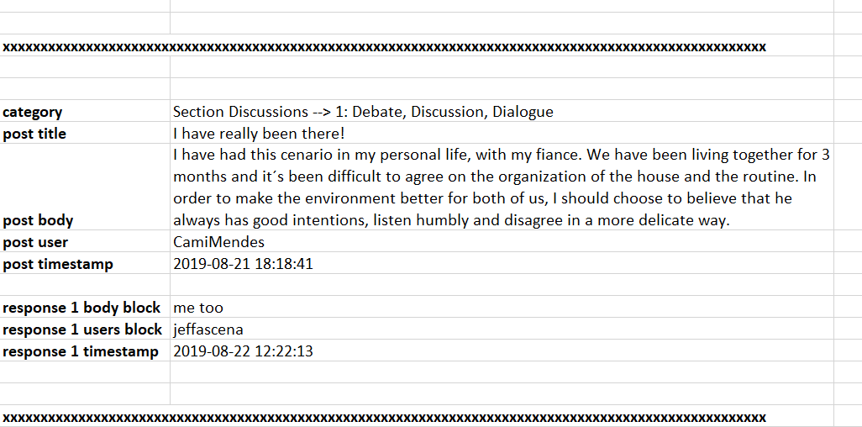
Notification report
YYYYMMDD--DB_Notification—COURSEDIR.xlsx
workspace
HTMLs folder
Course 1
Course 2

Slide 21
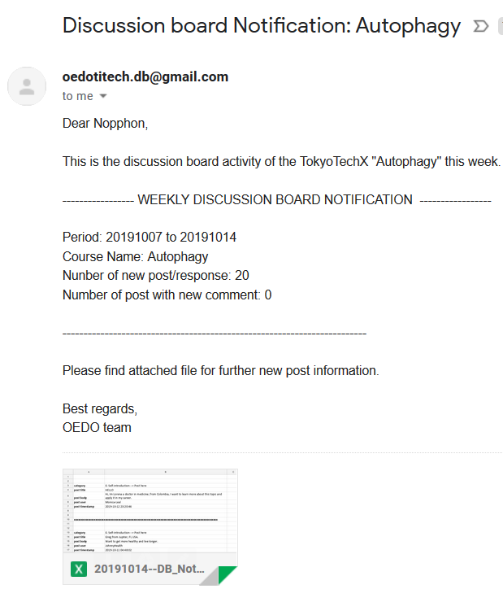
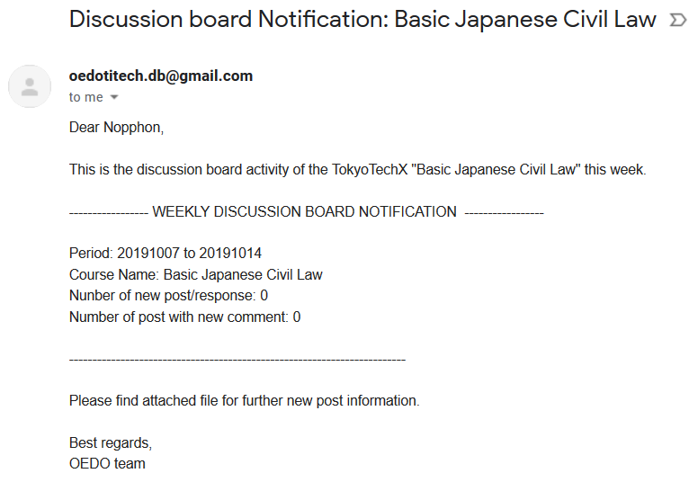
Email example
Notification with new activities
Notification with NO new activity
Person with FLAG = no will not receive this email
Report attached in excel format

Slide 22
Adding a new course in the system
Add course info in course table.xlsx according to slide 13 and 17
Follow instruction slide 9 but selecting the 1st option to select course manually
Then select only the new course to be initially scrape all DB data
DONE. In the next cycle, system will also check for the new course

